Slide 1

GAME DESIGN DOCUMENT (GDD)
Game Name: Climb High
Genre: 2D Platformer
Game Elements:
Player:
The number of players that can play the game at once are for the moment only one but with some help in our project we can make it available online.
TECHNICAL SPECS
Technical Form: It is a 2D challenging platformer game to climb to the top of the level.
View: Third person Viewing
Platform: PC
Language: C#
Device: PC
GAME PLAY:
Our basic gameplay currently includes a palntin a boot that has to climb up the platoforms and reach the top of the level to get the mushrooms. We currently have only one character model but we also intend to add more variety of characters into the game.
Game Play Outline
This outline of our game is simple for beginners.
Opening the game application
Main Menu Screen pops up.
Click on the Play option and enjoy the game.
Try to reach the top of the level.
If the user is annoyed or gets impatient just click on the pause button and quit the game.
Key Features
Reaching the top of the level and getting the mushroom is the main goal of this game. Players have to go through difficult challenges and have to make difficult jumps and not get angry if they lose progress as there are no checkpoints.

Slide 2
DESIGN DOCUMENT
Our game is a basic 2D platformer game without any checkpoints to make it as challenging and enraging as possible.
Design Guidelines
The design is made keeing in mind that it has to be as difficult as possible to reach the top of the course. Also at the same time it needs to be entertaining for the user as well.
Game Design Definitions
The game doesn’t have any specific levels in it but the difficulty of the game keeps on increasing in the same level itself. The jump between the platforms get harder and would need more precision to it possible and try not to lose a lot of progress.
Game Flowchart
The game starts off with the player at the bottom of the level. The game is a long climb to the top. The game can lead to anger if the user falls from top to the bottom. A player can take as much time as possible to reach the top. Winning and Losing can be decided by the amount of time taken by the user to reach the top or quitting the game after falling down respectively.
Player Definition
Our player is an Plant in a Boot.
The character has collidors which can sense it being colliding into an platform or slope and resulting in either increasing or decreasing the progress.
Our Character (Plant) has no health.
It will automatically get ‘no friction’ as soon as it lands on a slope.
It has no weapons.
Player Properties
Plant has jump property which keeps on increasing when holding the jump button till it hits the max limit.
Plant can move left and right.
Player Rewards (pick-ups)
User can have rewards such as mushroom achievment which depends on what type of mushroom they took, get different skins of the Plant, so on and so forth.
User Interface (UI) :
We have done a fairly simple interface where a User can simply click on Play Game and get straight into the game. User now needs to dodge the incoming buildings and avoid crashing into them. If he crashes he is returned to the main menu. To make sure that the user is ready after hitting Play Game, he is given a 3 second countdown after which the game begins. The Achievements menu shows the hogh score of the User. Store will be displaying more aircrafts being added into the game.

Slide 3
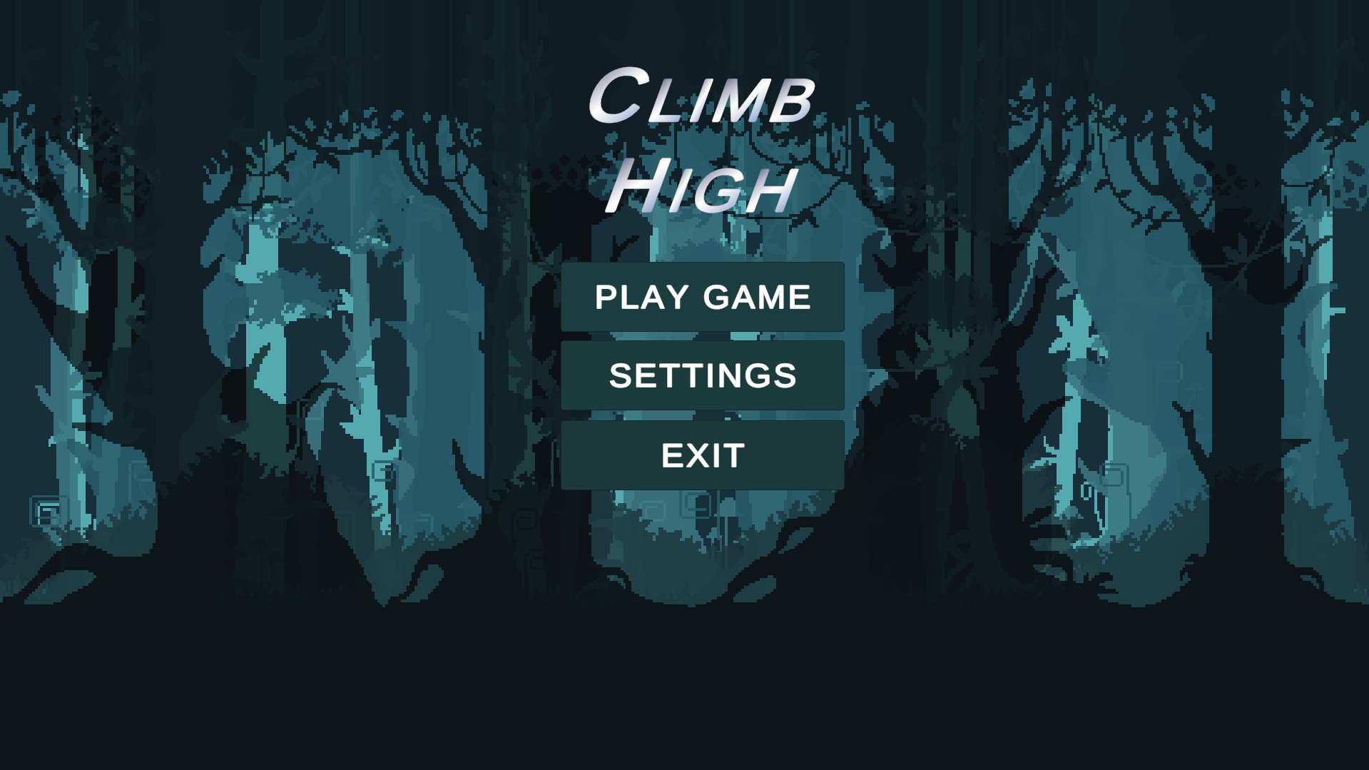
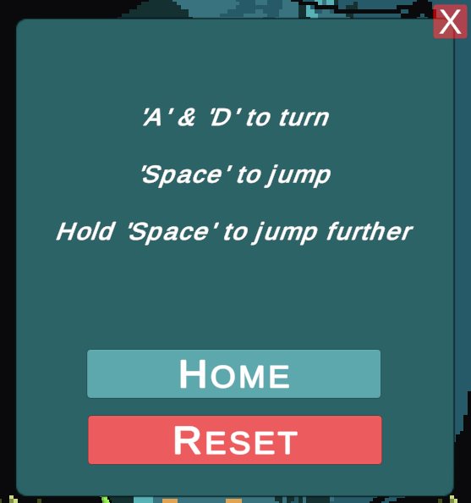

Slide 4
• • | Accessibility – the game controls are for the time being only three keys. Left Arrow Key / ‘A’ Key to move the plant left, Right Arrow Key / ‘D’ Key to move the plant right and ‘SpaceBar’ to make the plant jump.
 | Intent Communication – these controls provide the user with enough control over the plant to make him feel that they are actually controlling it.
 | Expression Space – the game controls can be even more dynamic and even more features can be added which can be made sure.
Let’s look at these principles in more details.
Accessibility Hand Limitations
If we want our controls to be easy to use, the first thing that we need to take into
account is our hand limitations.
There are three main ―finger groups‖ that we need to keep in mind during controls
design:
• • • | Primary control – Right/Left Index Finger
 | Secondary control – Right/Left Ring Finger
 | Support – Thumb
 | .
Let’s try to apply our knowledge of hands limitations for the more practical task – designing of the game controls layout. In order to do that, we can use a Fitt’s Law , which for our case we can formulate that way: ― t h e fewer the distance to the button and the bigger the button, the more accessible the button is.‖
Combining Fitt’s Law and knowledge of hand limitations, we can formulate the basic principle for controls layout design:
The most frequent actions should be in the most accessible places and match primary control group of the player’s hand.
Accessibility Tiers: Gamepad
For the gamepad, it might look like this (as an example, we can use very common Xbox 360 Controller):

Slide 5
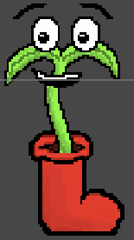
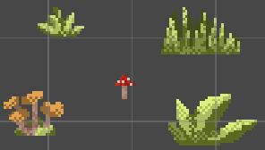
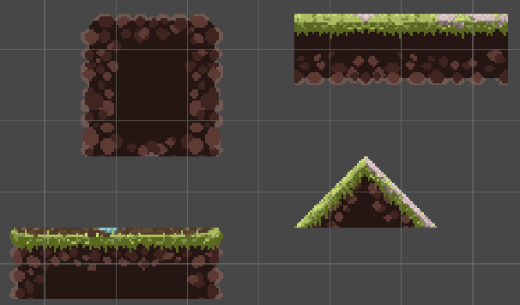
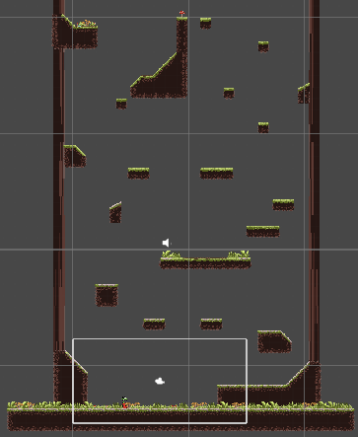
Accessibility Tiers: Keyboard
We have used Right Arrow, Left Arrow, ‘A’, ‘D’ keys and ‘SpaceBar’mainly for now as to direct the plant to make the jumps between platforms.
The final assests were taken from the free asset store of the Unity.
We added the assest into the game. After which the game looked like this.

Slide 6
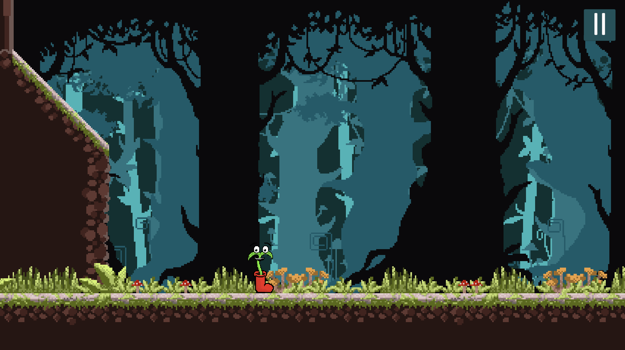
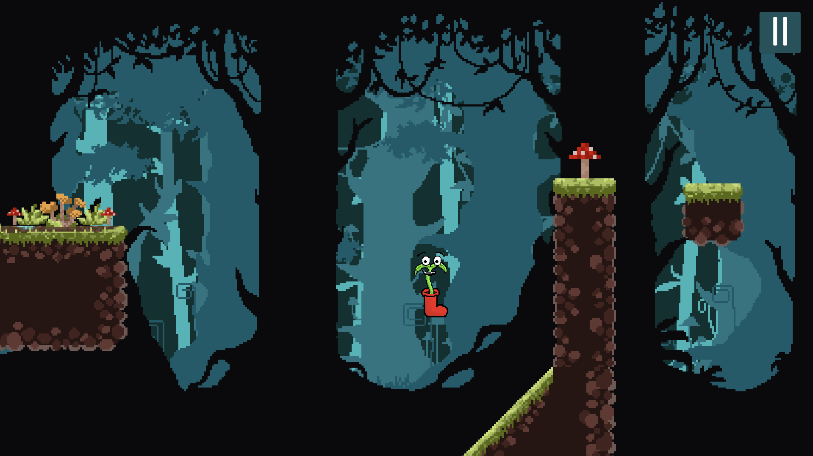
Now that the Game was developed and some progress is made. We thought of adding extra items like a Background, Sounds, Main Menu and Settings Panel.

Slide 7
Non Player character in games :
The acronym "NPC" refers to non-player characters, an important aspect of most video games.
An NPC is any character not controlled by either the player or an AI, and can be an important character, or simply populate a game's world.
NPCs are different from CPUs, which are computer characters meant
to act like a real person.
As this game is a 2D platformer game only for the player to reach the top, right now it doesn’t require a NPC. If a possibility comes in the future then an NPC will surely be implemented in the game.

Slide 8
Building UI Canvas
A canvas in a game is a graphical component that is used to render 2D or 3D graphics on the screen. It is a container that holds all the graphical elements of a game, such as images, text, and buttons. The canvas is responsible for rendering these elements in the correct order and position on the screen. It is also responsible for handling user input events such as mouse clicks and touch events ¹.
In Unity, a canvas is a component that is used to render UI elements such as buttons, text, and images. It is a fundamental part of the Unity UI system and is used to create user interfaces for games and applications ¹.
The canvas component in Thunkable is a touch-sensitive panel that enables the movement of items. It can be used to create a variety of games and experiences that
involve different methods of touching a screen ².

Slide 9
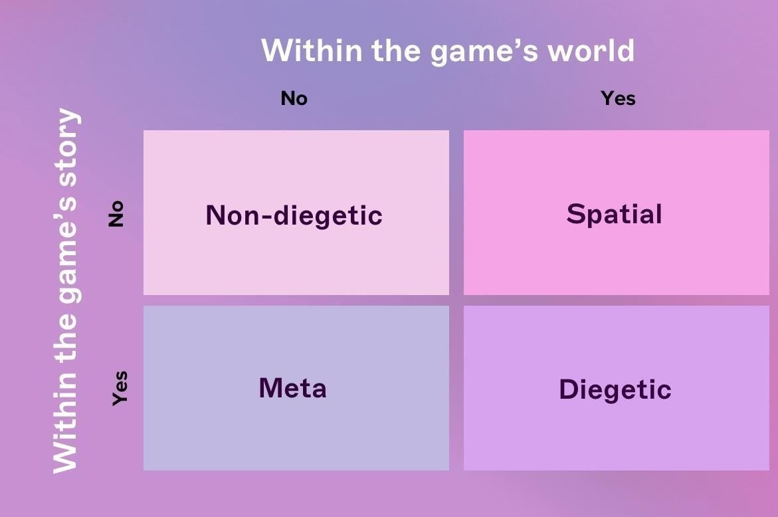
User Interface
Understanding interface components in game UI design
When it comes to game UI design, there are four types of visual representation: diegetic, non-diegetic, spatial and meta. To become a great game UI designer, you first have to understand what these mean and how you can use them effectively. Let’s break them down.
Diegetic: UI elements that can be seen or heard by the character and fit within the story’s context. Examples: a phone with a visible screen, holograms, and other futuristic gadgets.
Non-diegetic: UI elements that exist outside of the game or story and that only the player sees. Examples: menu screens, quest windows, and health bars.
Spatial: UI elements that are represented within the game space but aren’t visible to the characters. Examples: character outlines indicating who the enemies are, an arrow showing where a thrown object will land, and text labels.
Meta: UI elements that are contextual to the game but aren’t represented within the game space. Examples: scrolling text or colored overlays that indicate a change in the player’s health status.

